Slide 1
Colour

Slide 2
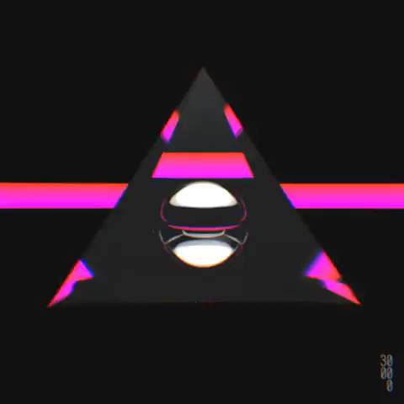
By the end of this Smart Lesson, you should be able to:
1. | Describe the relationship between frequency and wavelength.
2. | Describe what happens when white light is put through a prism.
3. | Explain how the absorption and reflection of different wavelengths gives objects their colour.
4. | List the primary and secondary colours of light.

Slide 3
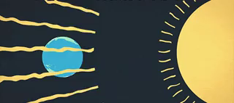
First of all, we need to understand that wavelength and frequency are very closely linked.
This is because all light waves travel at the same speed in each medium.
For example, every light wave travels at 300,000 km in one second in space.

Slide 4
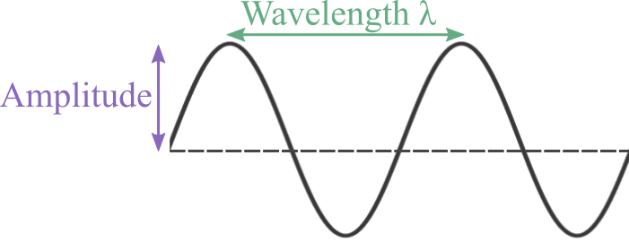
We use the following formula to work out the wavelength and frequency of a wave:
v=fλ
v is the velocity of the wave, f is the frequency, and λ is the wavelength.
Velocity is always the same in each medium, so if a wave has a high frequency it must have a short wavelength, and vice versa.

Slide 5
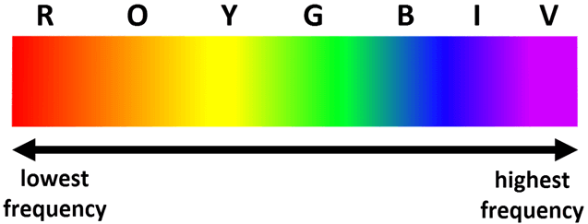
We can arrange the colours in a spectrum based on their frequency or wavelength.
You may notice that this is the same order of colours in a rainbow! This isn't a coincidence - a rainbow occurs when white light is split into different colours to produce a colour spectrum.

Slide 6
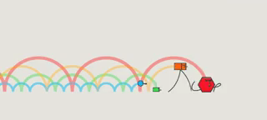
The colour spectrum diagram showed that red has the lowest frequency while violet has the highest frequency.
This means that red light has the longest wavelength and violet light has the shortest wavelength.

Slide 7
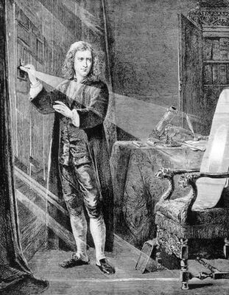
In the 1660s, Isaac Newton discovered something amazing about white light.
He discovered that white light - light that is not coloured - is actually made up of a combination of all other colours.

Slide 8
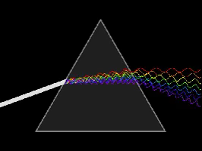
We can see this phenomenon when we use prisms.
Prisms are used to split white light into the different colours.
There's a complicated reason for how this works, and it's all to do with refraction. If you'd like to know more about refraction, you can have a look at this Smart Lesson.
Essentially, the different colours bend by different amounts as they go through the prism caused by their different wavelengths.

Slide 9
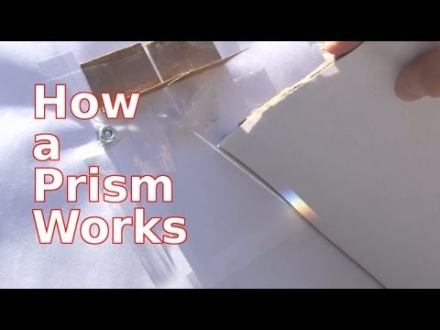

Slide 10
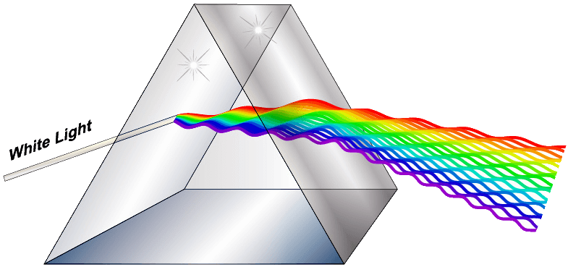
Red light bends the least as it travels through the prism.
This is because it has the longest wavelength of all visible light.
Violet light bends the most in a prism. This is due to its short wavelength.

Slide 11
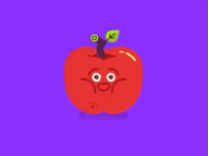
What causes objects to be coloured differently?
Why is an apple red and the sky blue?
The answer to these questions can be explained by the reflection and absorption of different colours of light.

Slide 12
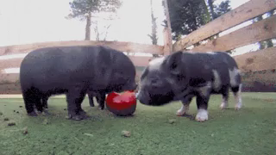
If an object is red, like an apple, it is because all colours except red are absorbed.
The red light is reflected by the apple. This makes it look red!

Slide 13
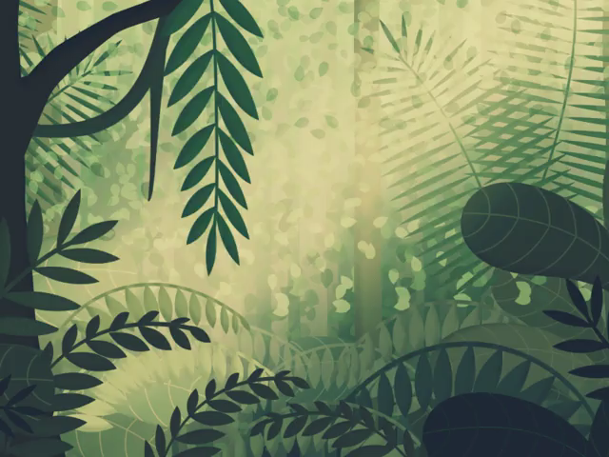
A green leaf reflects the green light.
All the other colours are absorbed by the leaf.

Slide 14
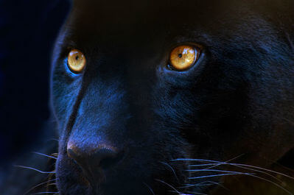
A black object has absorbed all colours of light and reflects none of them.
This is why black objects get hotter faster in the sun - they are absorbing more energy.

Slide 15

A white object has not absorbed any colours of light and reflects all of them.
A white object is reflecting white light back at you.

Slide 16

But wait, how do we actually see the different colours of visible light?
The human eye has specialised cells, called cones, that detect the different coloured wavelengths.
There are different cones for each primary colour.

Slide 17

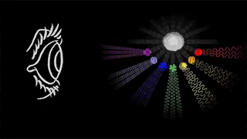
There are three primary colours of light - red, blue and green.
White light is produced when these three colours are shone together.
You may have learnt that the primary colours are actually red, blue and yellow. This is also true! These are the primary colours of pigment.

Slide 18
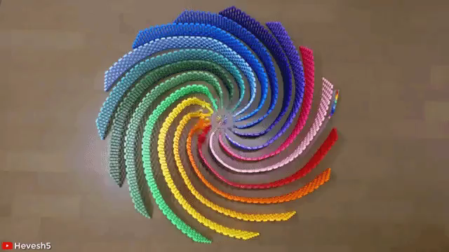
When we shine two primary colours together, we produce secondary colours.
The secondary colours are magenta, cyan and yellow.

Slide 19
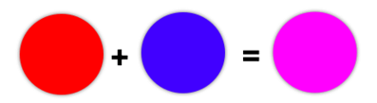
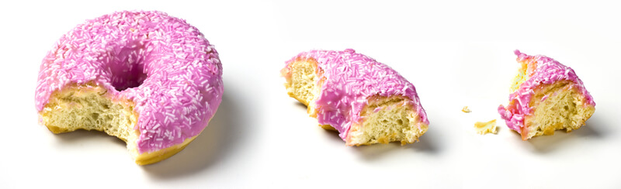
Red and blue combine to produce magenta.
The icing on this donut is magenta, which means that it reflects red and blue light and absorbs everything else. It is also delicious.

Slide 20
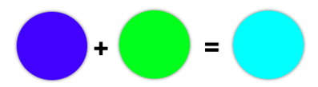
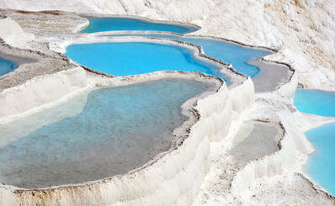
Blue and green combine to produce cyan.
The water in these lakes at Pamukkale, Turkey, are cyan. This means that they reflect blue and green light and absorb everything else.

Slide 21
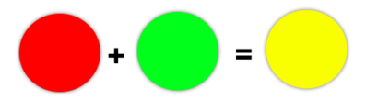
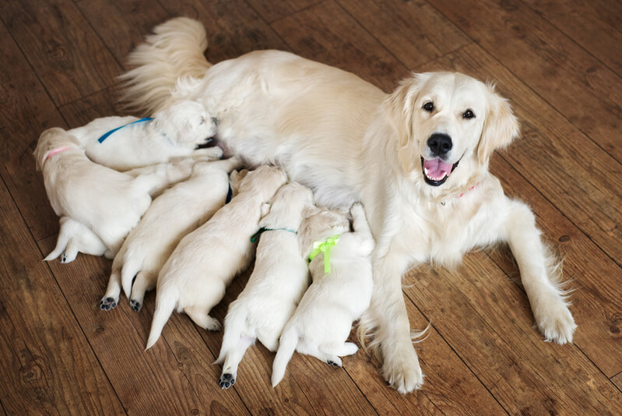
Red and green combine to produce yellow.
The fur on these golden retrievers is yellow. This means that their fur reflects red and green light, and absorbs everything else. They are also adorable. Yes they are!

